Slide 1
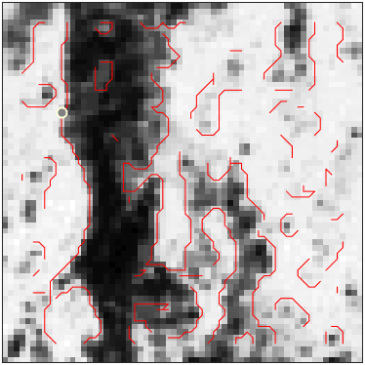
example of a texture patch with detected contours

Slide 2
Finding theoretical distributions for different empirically sampled features
Different features, eg power spectrum, histogram, edge contour number, density, length, edge power etc. have different empirical distributions for different textures (both in the texture discrimination problem, or for blank vs target in camouflage detection).
We have some guesses for what some of these are (eg, independent exponential power spectrum, but it remains to be thoroughly tested, or multinomial histogram, or exponential contour length).
A more proper way would be some standard protocol to test how well some theoretical distribution fits these empirical distributions. This both enriches our knowledge of true natural statistics, and makes our brain models better because they use better-matching theoretical distributions.
An example of how to do this, for contour length:
Measure a set of contour lengths for each of many patches of a texture.
Now let’s say we assume exponential distribution of contour lengths. First find the ML exponential parameter from the pooled data (here, mean length).
Then compute the likelihood of the length-set of each patch. This gives us a distribution of empirical likelihoods.
Now simulate ‘observations’ from this ML theoretical distribution, and generate the likelihoods of those length-sets.
Now compare the distribution of the emprirical likelihoods vs bootstrapped likelihoods. We can plot the distributions together. We can also compute their KL divergence (which is related to the likelihood of one distribution under another). We can also see how far is the mean empirical likelihood as sd’s from the bootstrapped likelihood mean (a confidence interval).
Now do this for each texture across a large database of textures (say Brodatz plus the newer database Bill emailed about).

Slide 3
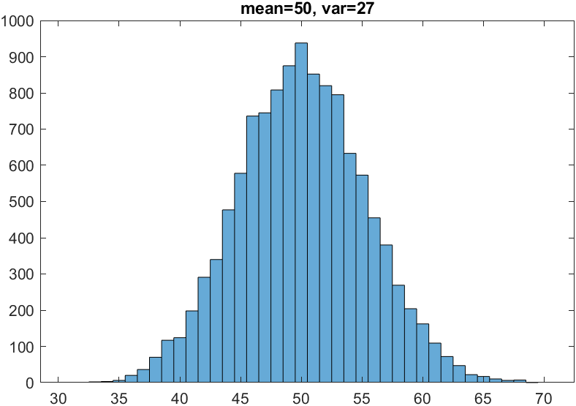
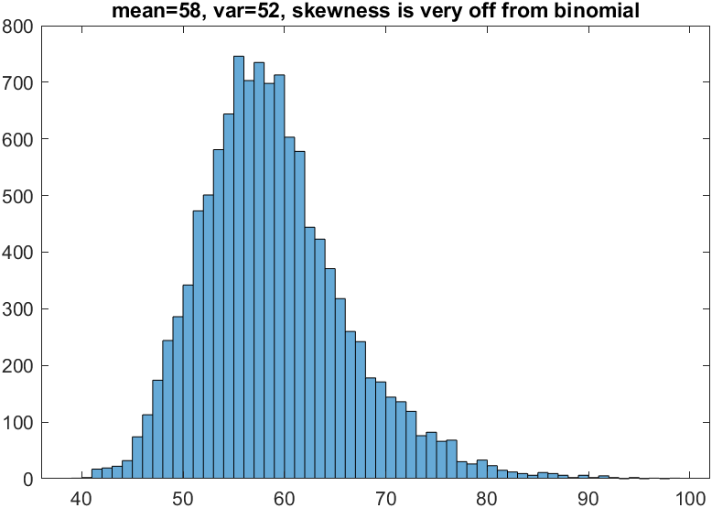
The number of contours is not Poisson distributed (mean not equal to var). It could be modeled as a Gaussian (discrete version is like Binomial), though sometimes the skewness is off.

Slide 4
Ideal Observer For Discriminating Unknown Power Spectra: Two-Interval, Two-Alternative, Same-Different Task
probability of same spectra
observed power spectra
decision variable
exponential distributions

Slide 5
assuming known power spectra of Gaussian noise
decision variable
single pair of image patches with arbitrary unknown power spectra
ML estimate of spectra
decision variable
normalization and weak signal suppression
Note that normalizing (scaling) all powers by a constant has no effect.

Slide 6
Ideal Observer for Discriminating Unknown Histograms : Two-Interval, Two-Alternative, Same-Different Task
observed number of each possible gray level
ratio of multinomial distributions

Slide 7
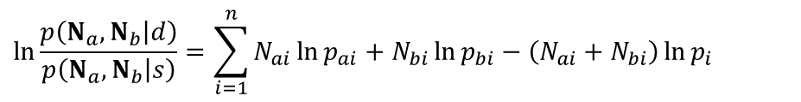
$$\ln{\frac{p\left(N_{a},N_{b}\left|d\right.\right)}{p\left(N_{a},N_{b}\left|s\right.\right)}}=\sum_{i=1}^{n}{N_{ai}\ln{p_{ai}}+N_{bi}\ln{p_{bi}}}−\left(N_{ai}+N_{bi}\right)\ln{p_{i}}$$
decision variable
We assume
Thus, if then

Slide 8
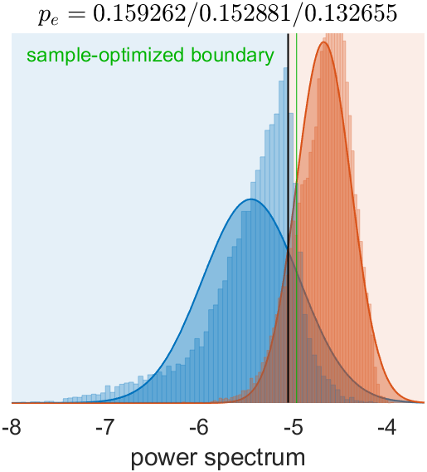
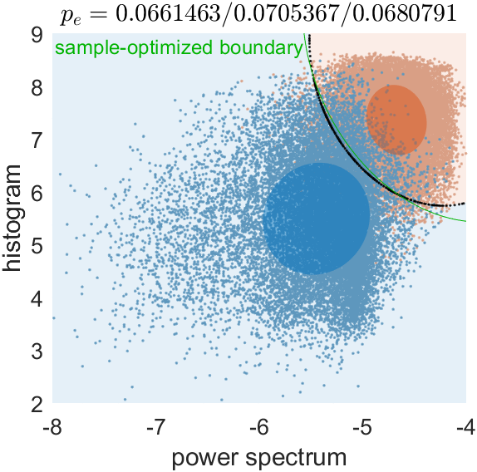
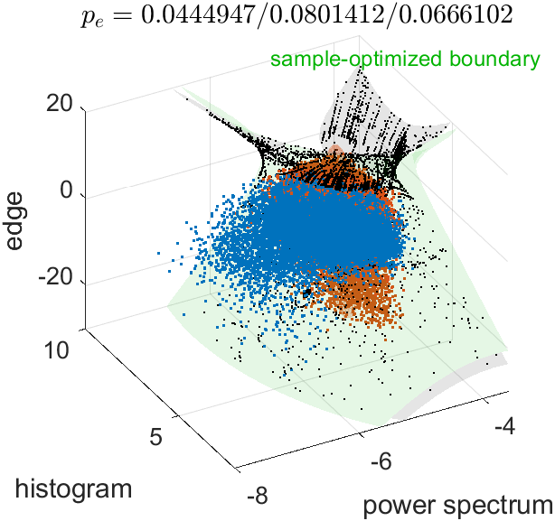
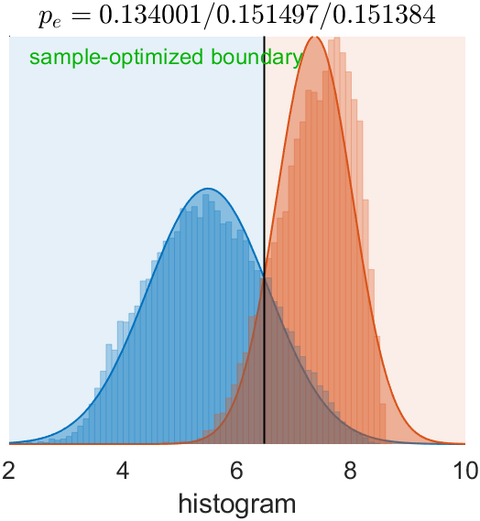
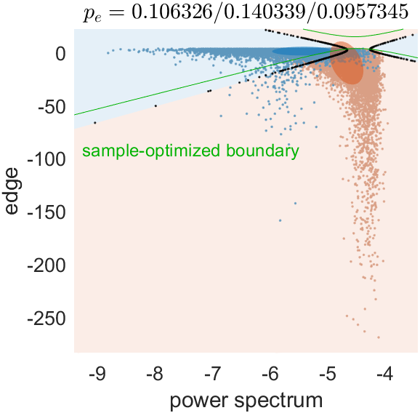
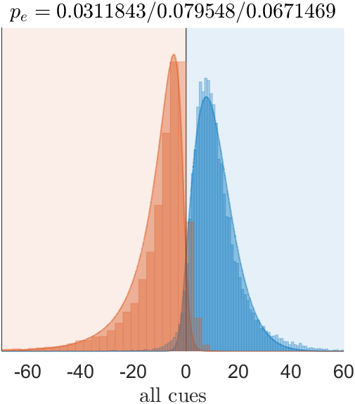
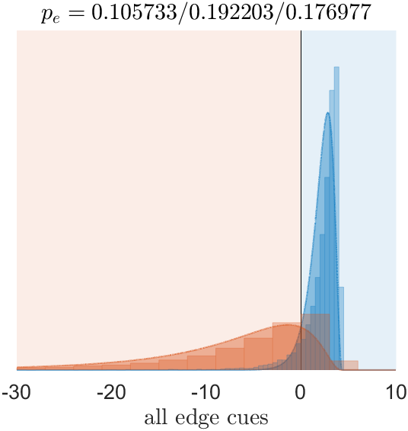
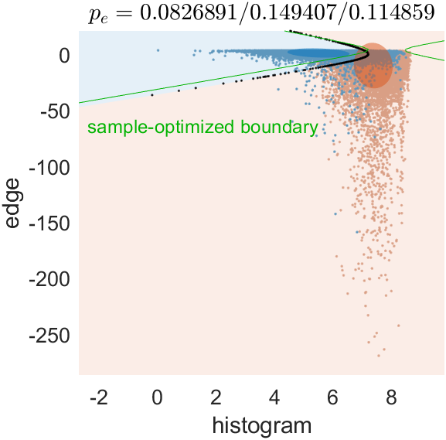
each cue individually
2-cue combinations
all-cue combinations
The 3 error rates are:
between the fitted normals with their optimal boundary,
between the samples with the optimal normal boundary,
between the samples with a sample-optimized quadratic boundary
Combining all edge cues first, then with the other two:
Combining all cues at once:
Combination sequence makes little difference.
Adding edge to histogram+power
worsens the 2nd error rate, possibly because edge variable is badly modeled by a normal
marginally improves the 3rd error rate (that starts from this poor normal boundary and optimizes for the sample)
Each of the 3 cues have roughly same accuracy.
Histogram & power are the best combination
Notes:
First pass at combining power and histogram with the (combined) edge cue. The different parts of the edge cue here are simple mean differences of the different edge features.

Slide 9
Phase pattern cue
This is the one where a texture patch is circularly shifted to match another one (maximize dot product) as best as possible.
This can improve discrimination in the cases where power spectrum, histogram etc are the same.
The function for this should still be intact in Bill’s shared code, but the line in the main script that calls it has been abandoned.
We can re-include this, after we speed up the function through the use of circular autocorrelation (dot product in Fourier domain)

Slide 10
Number of Contours Cue
assume Poisson distributed
decision variable

Slide 11
Contour Length Cue (normal assumption)
decision variable

Slide 12
Contour Length Cue (exponential assumption)
decision variable

Slide 13
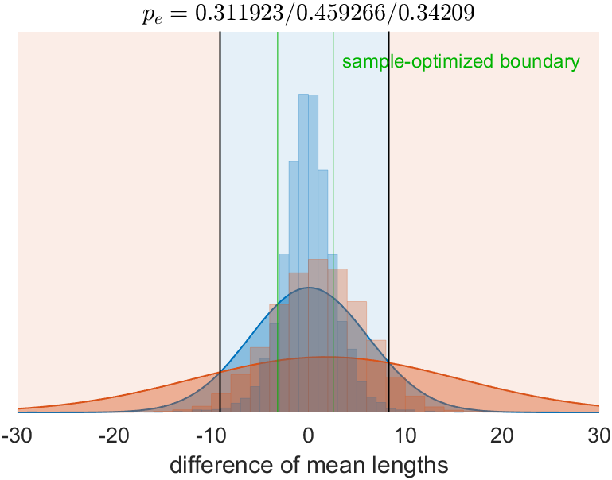
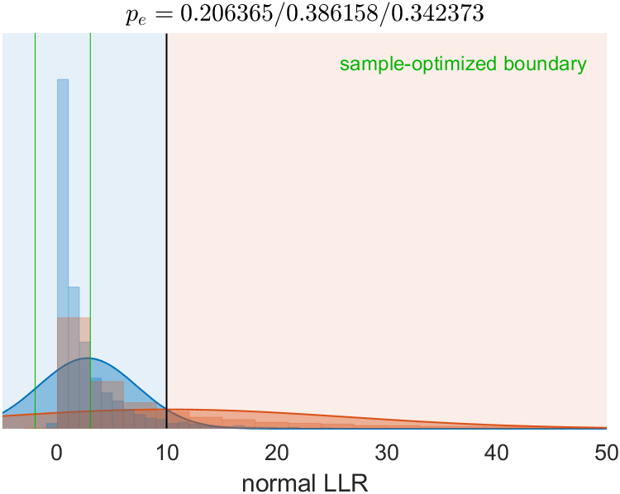
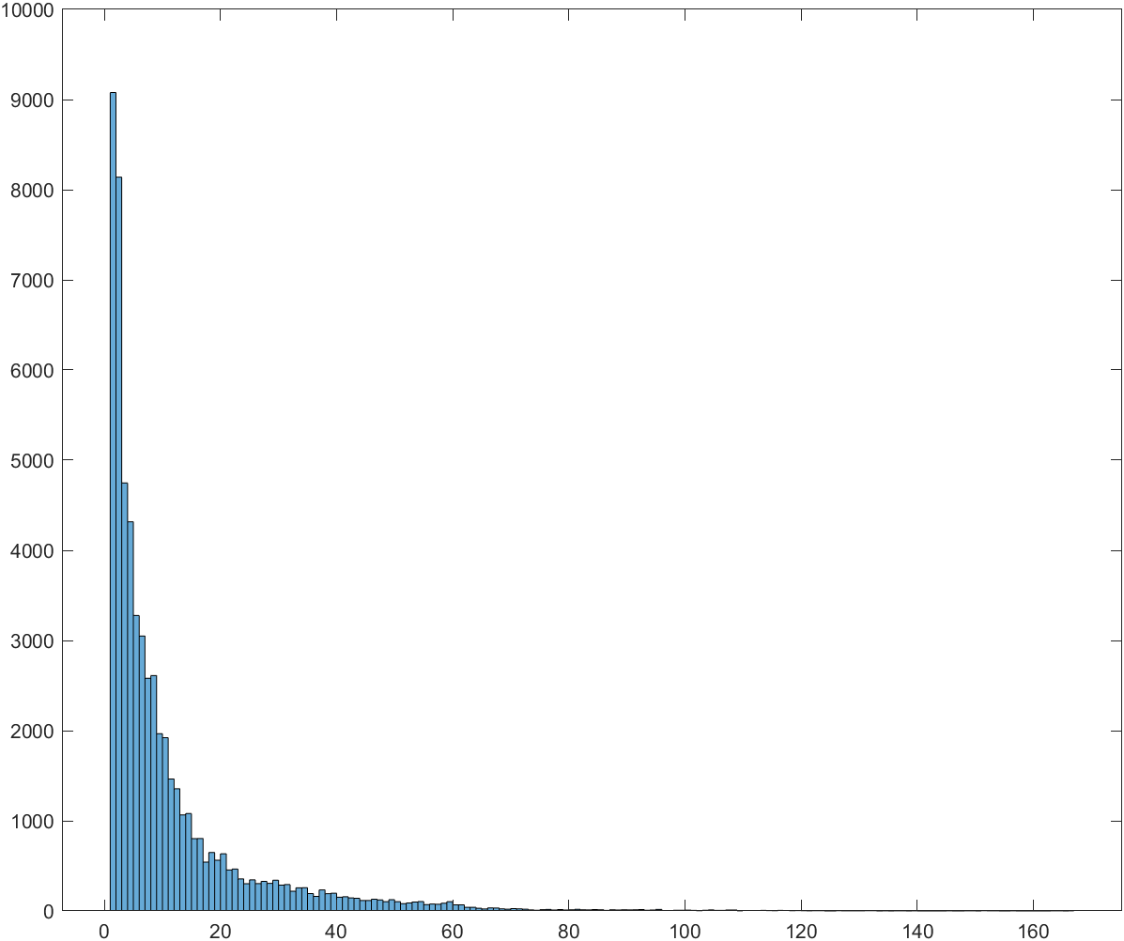
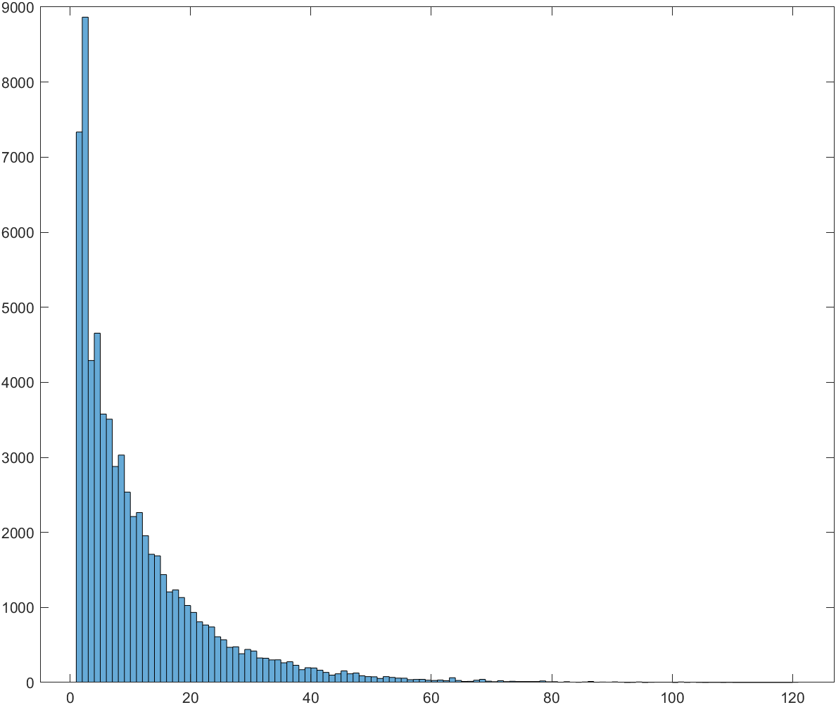
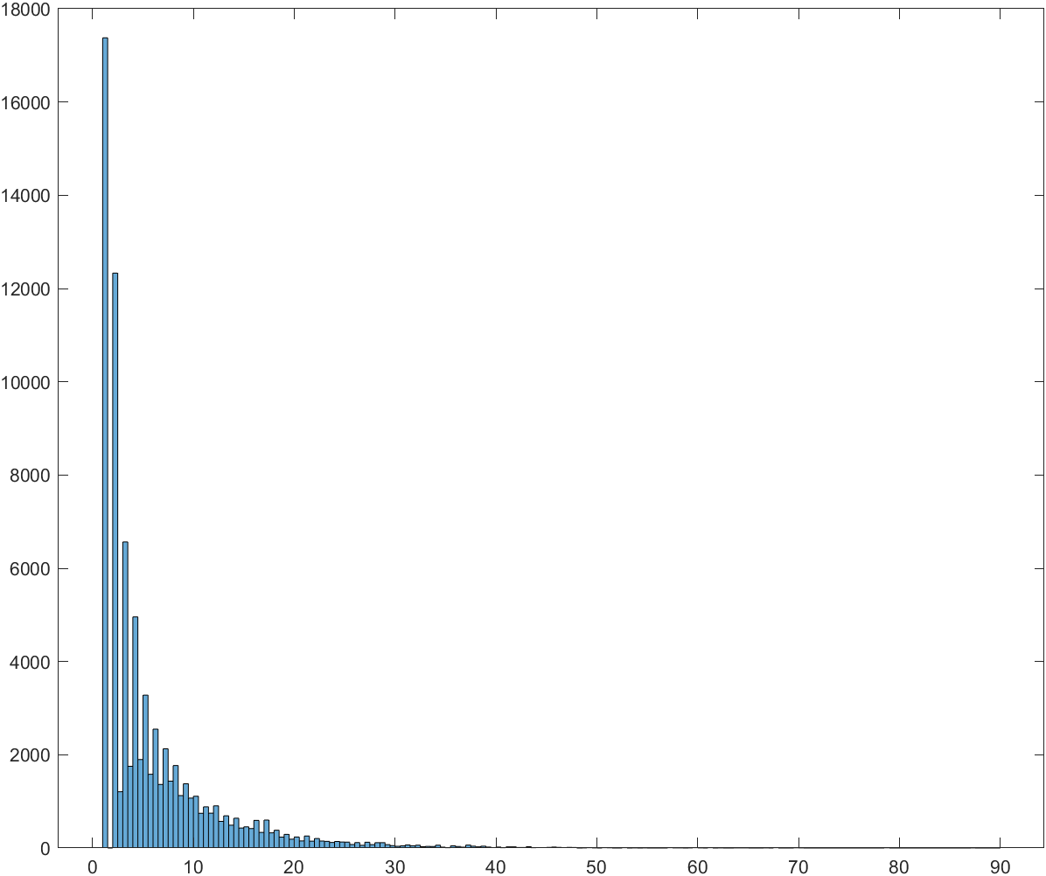
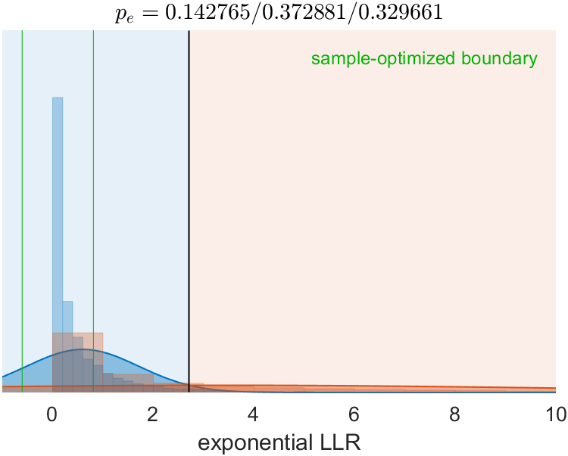
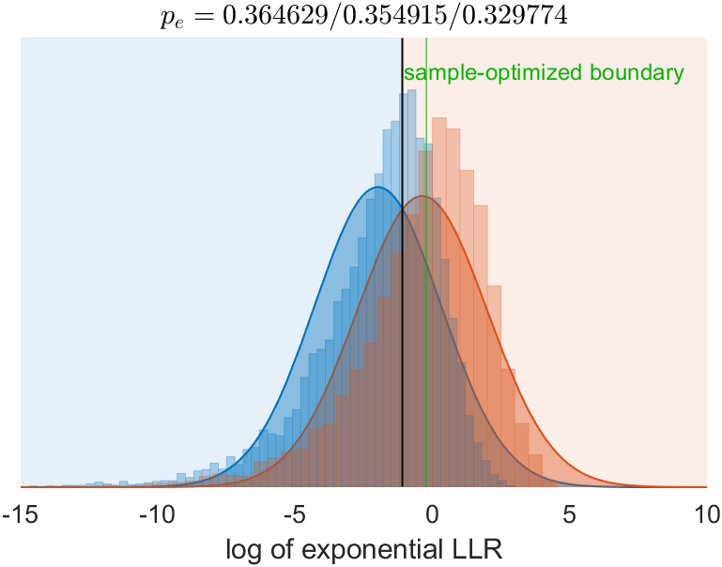
1. We first used just the difference in the mean contour length between the two patches as the dv.
2. Then made the dv more sophisticated using an LLR assuming contours come from two different normal distributions, vs one. This takes into account the distribution of all lengths, not just mean. But this didn’t improve performance, and the dv became less normal (which is bad when combining with other dv’s).
3. Then I found that contour lengths are actually quite exponentially distributed across the different textures. The means were similar to the sd.
4. Then we constructed a dv which is the LLR assuming exponential distributions. This dv was still similar performance and not normal.
5. The log of this exponential LLR is more normal. It makes sense that performance is same as using mean difference, since the mean has all the info of an exponential distribution.

Slide 14
Simple CNN Model (first pass)
Model
Model: a simple CNN (similar to the DQN network)
Conv1 -> Conv2 -> dropout(0.25) -> Conv3 -> dropout(0.5) -> FC1 -> FC2.
Shape: 64x64x2 -> 31x31x32 -> 15x15x64 -> 7x7x64 (3136) -> 512 -> 2.
NLL loss, Adam optimizer (lr=1e-4), batch size=64, epoch=50.
Task 1 (discrimination)
Train: 100K pairs from 60 classes.
Test: 10K pairs from 60 classes.
Task 2 (generalization)
Train: 100K pairs from 50 classes.
Test: 10K pairs from 10 unseen classes.
To consider biologically plausible CNN architectures, read Yamins & DiCarlo review (2016 Nature Neuro)

